Slide 1
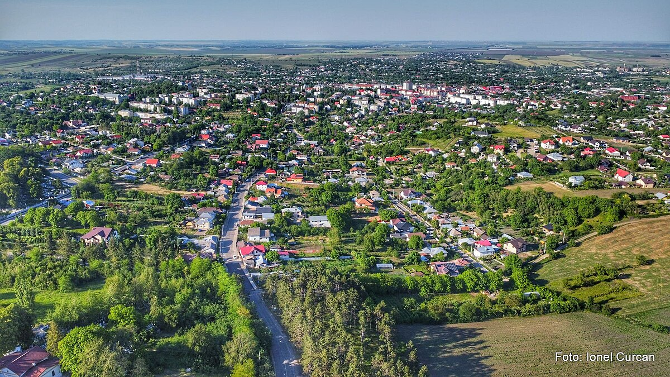
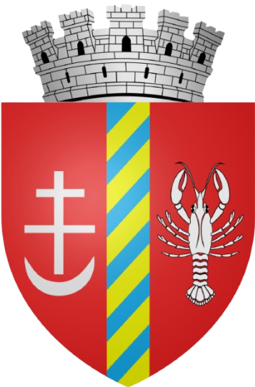
WELCOME TO DOROHOI

Slide 2
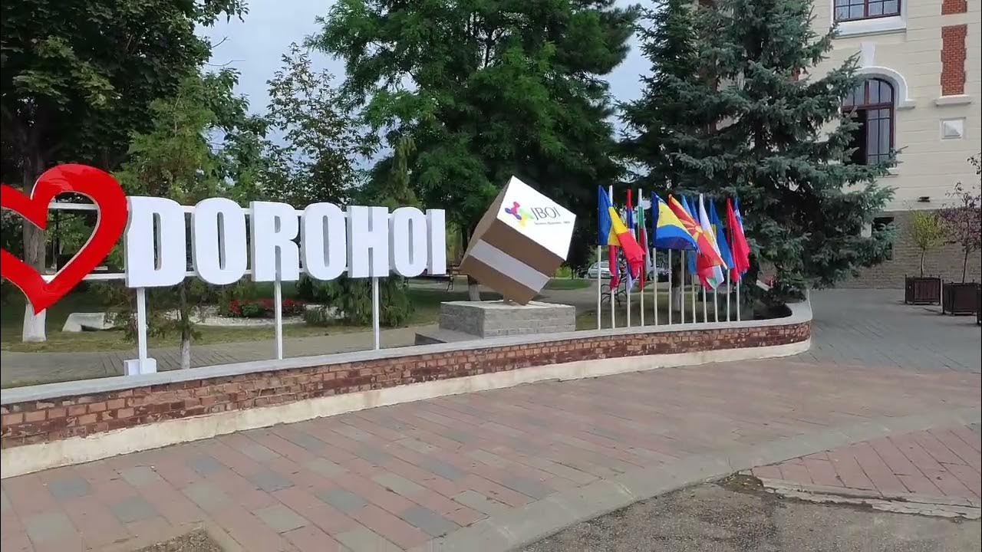
Greetings everyone! Our names are Ștefan and Adrian. We are both very excited to show you a quick tour of our beloved city, Dorohoi!

Slide 3
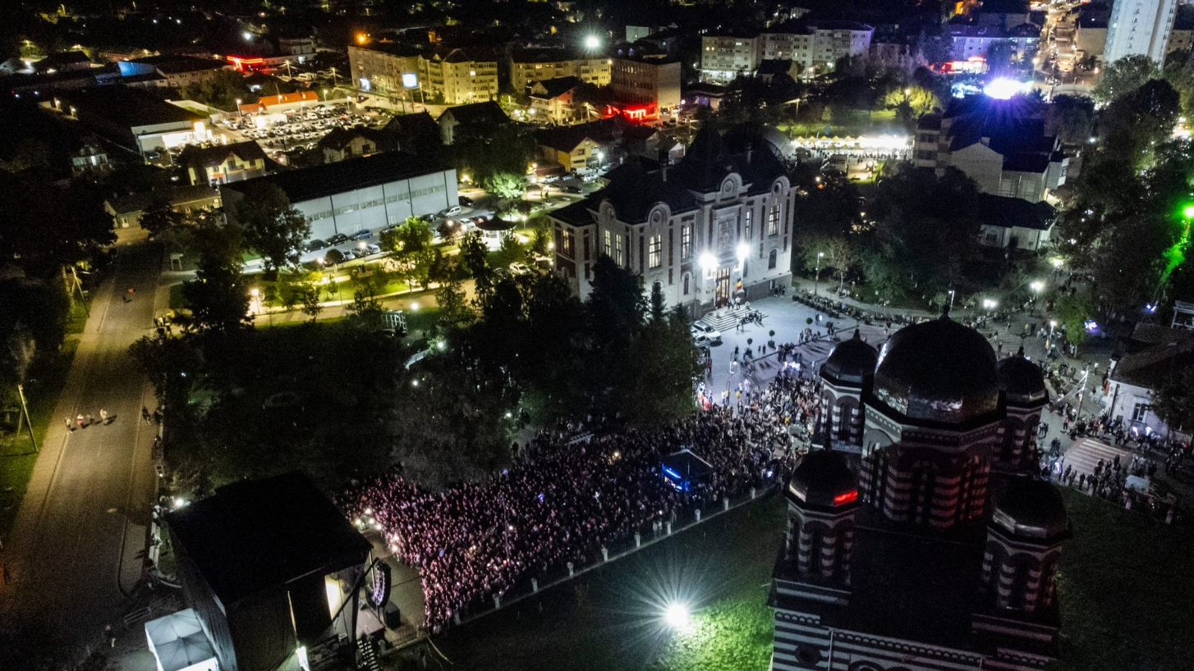
ABOUT
THE CITY
Dorohoi is a city from Romania, located in the county of Botoșani, in the north-eastern region of the country.
In our city there live arround 23,000 people, mainly Romanians with a few people of other ethnicities like Roma, most of them are Orthodox with minorities of other denominatons.
The city has a surface area of about 60 km², being even bigger than Botoșani the city of residence in the county.
Dorohoi was first mentioned in 1407, when the Moldavan boyars renew in the city of Lviv. It developed as an important trade and craft center due to its position between Moldova and northern trade routes. Over time, Dorohoi became a military and administrative hub, especially in the 19th–20th centuries and is also known for its multicultural past

Slide 4
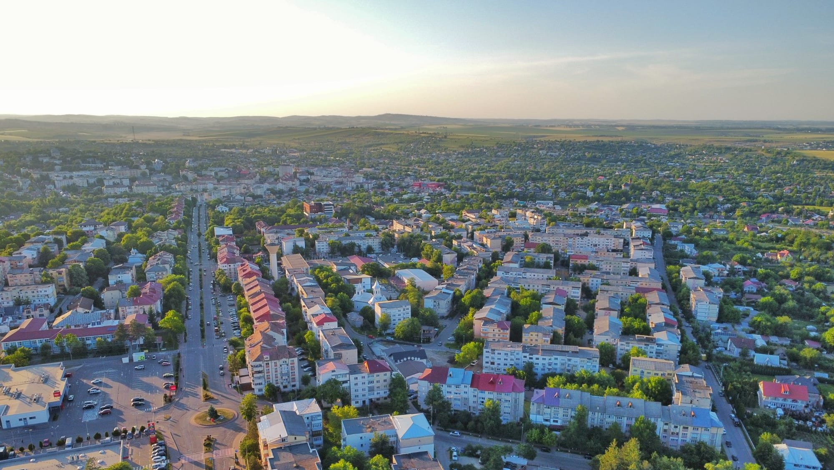
NOTABLE EVENTS
In the early 20th century, a high amount of Jewish people moved here because of the series of events taking part in that era. They were very active in local life and even today there are some of them here. This comes to show that our city has a variety of people and that we can tolerate and help eachother!
Unfortunately, in June of 2010, heavy rain caused the Buhai River to overflow, flooding parts of Dorohoi, damaging homes and infrastructure.
Lately, the European Union has been funding several projects in our city, such as school renovations, road repairs and infrastructure upgrades, bringing a huge impact to the quality of life.

Slide 5
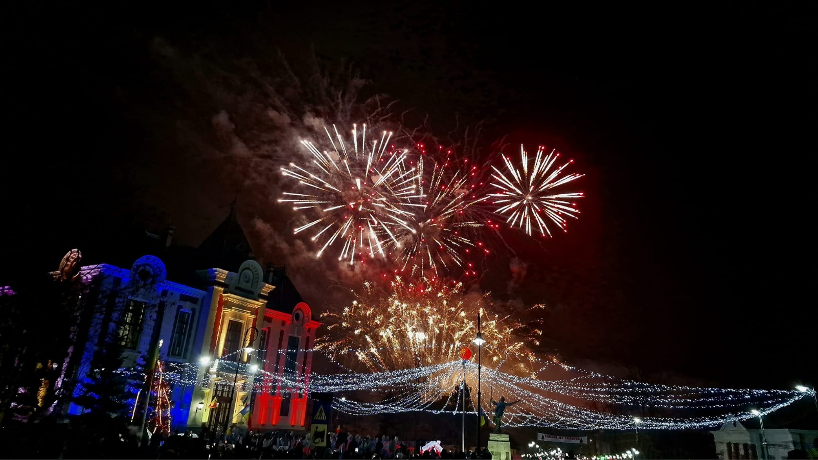
HYSTORICAL HALL OF FAME
Local Jewish merchants & intellectuals (1800s)
Influential in trade, education, and urban development, shaping the town’s economy. Most worthy of mentioning would be Ion Călugăru (1902–1956)
George Enescu (1881–1955) World-renowned composer and violinist, born in Dorohoi, Romania’s most famous musical figure.
Maurice Hartt (1895-1950)
Canadian politician, that was elected to the Legislative Assembly of Quebec and then to the House of Commons of Canada.
Benjamin Abrams (1893-1967)
American Businessman and founder of Emerson Radio & Phonograph Records.
Păstorel Teodoreanu (1894-1964)
Poet, lawyer and writer. Most known for his work entitled “Hronicul măscăriciului Vălătuc”.
Military commanders stationed in Dorohoi (19th century) Strengthened the town’s role as a regional military center. Between these awesome people counts Nicolae Samsonovici
Dumitru Chipăruș (1886-1947)
Famuous sculptor and ceramist from Dorohoi. The biggest collection of his works contains 120 of his originals and is in Moscow.

Slide 6
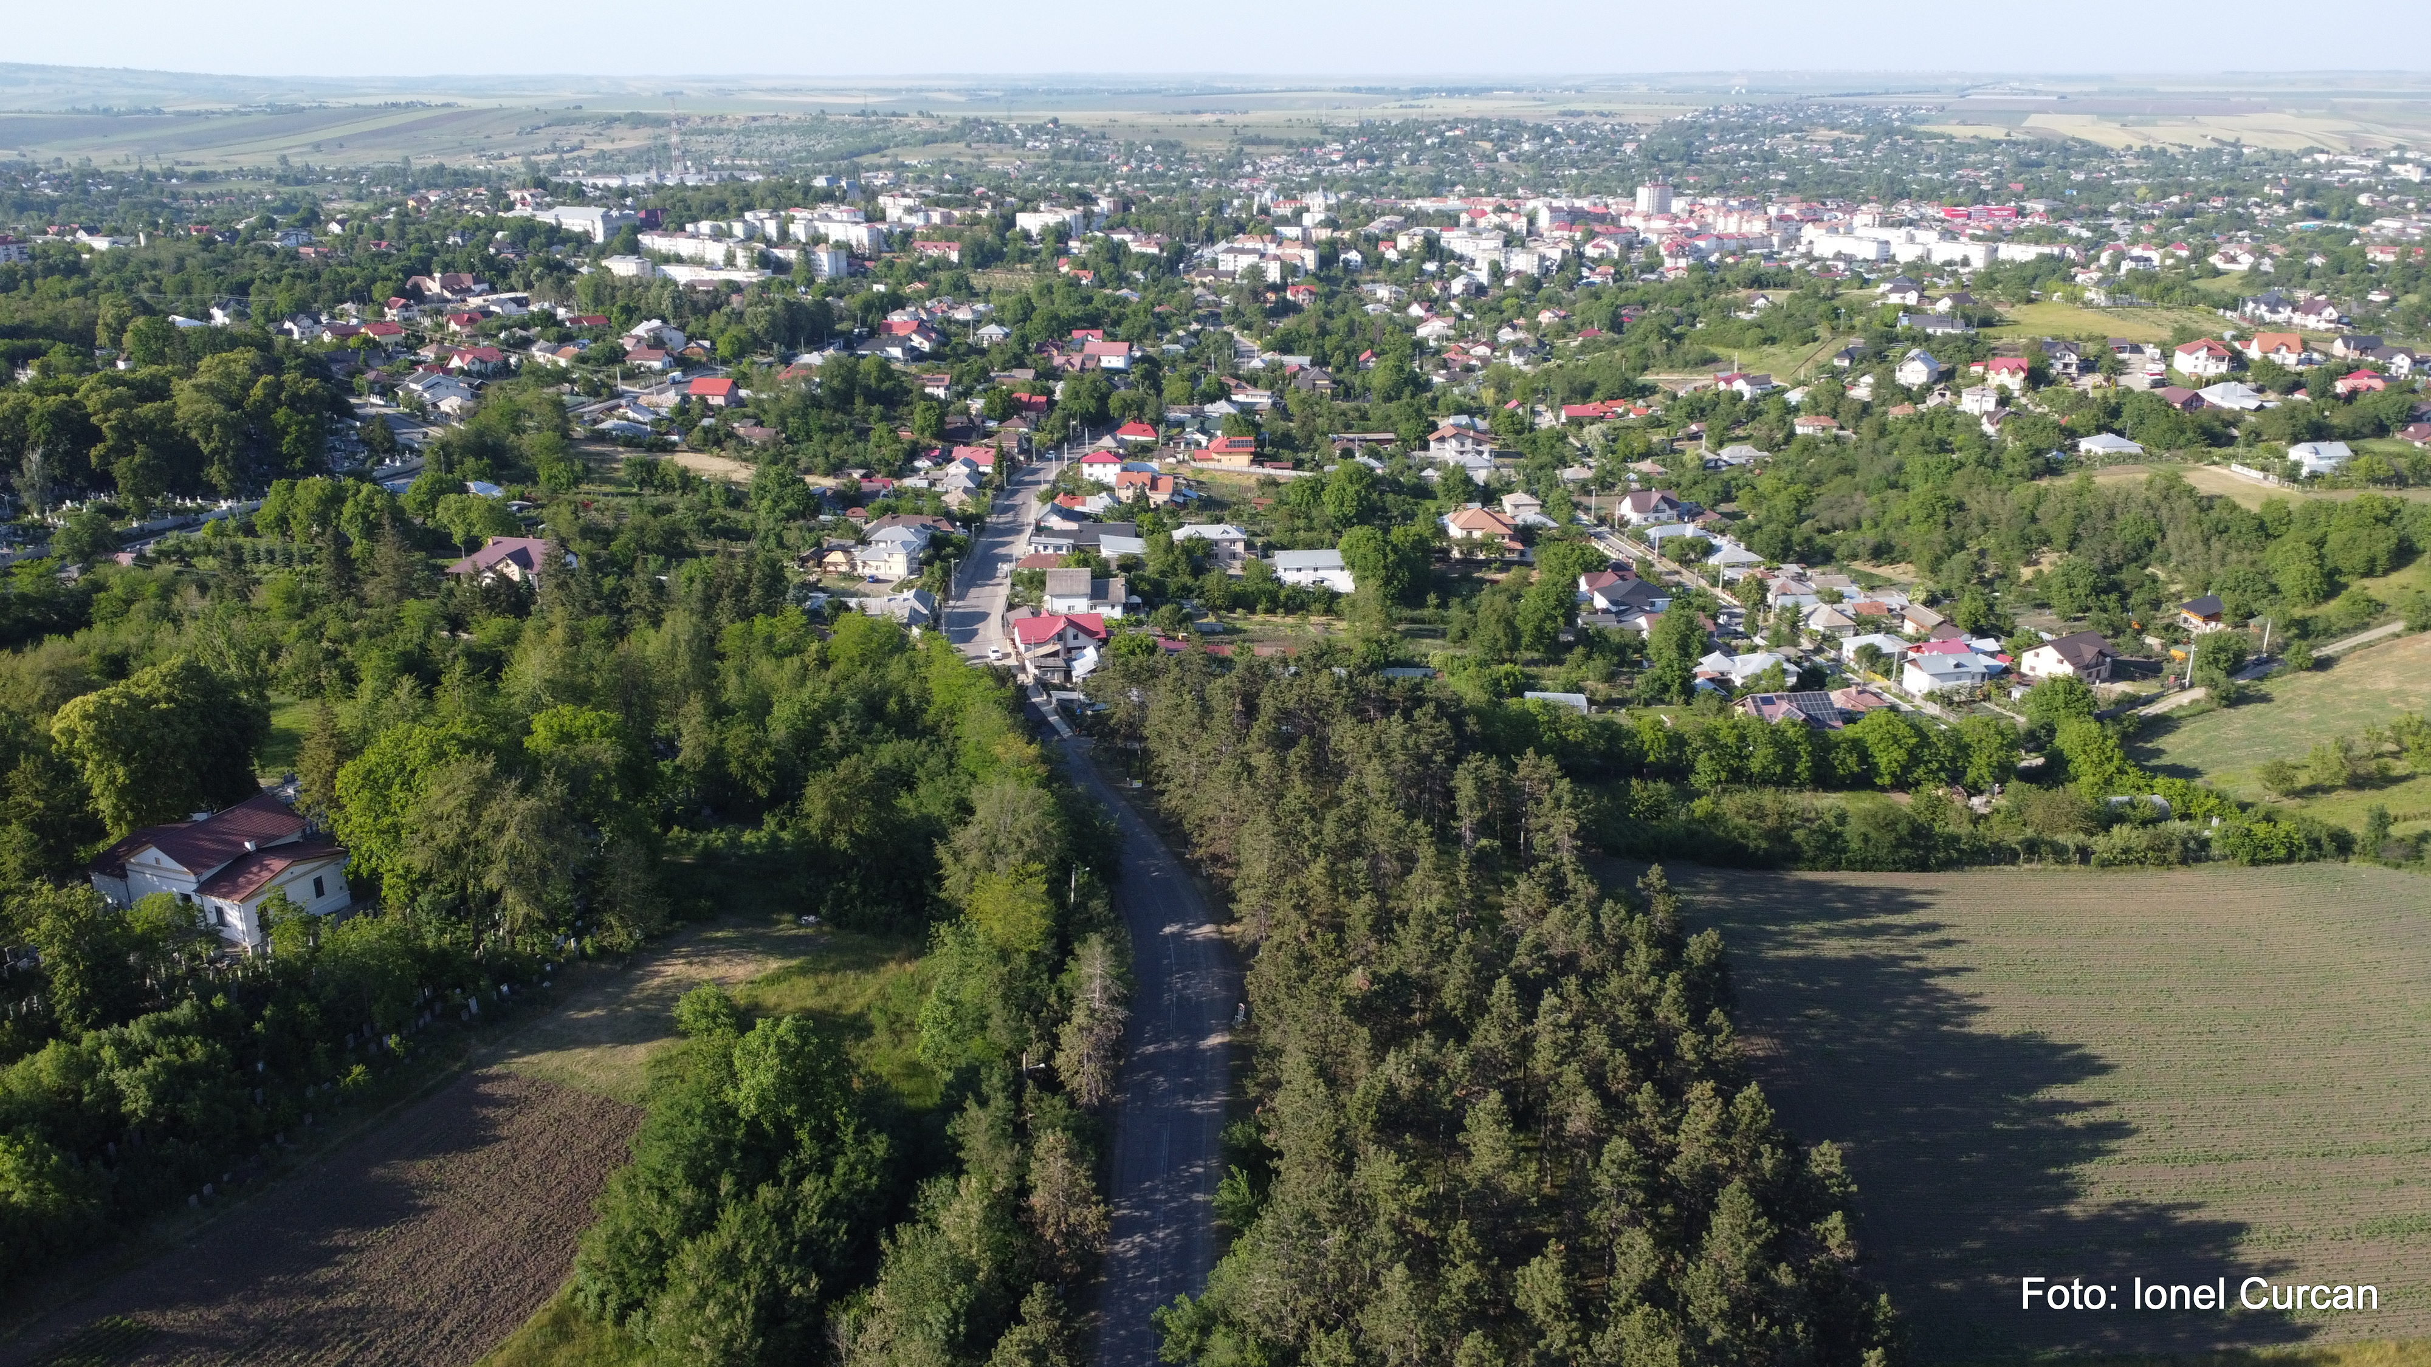
TODAY’S
HALL OF FAME
Vlad Dragoș Aicoboae (1993) Olympic rower
Dan Condurache (1952)
Film actor
Marius Șuleap (1979)
Retired midfielder for Romanias national team
Gheorghe Liliac (1959)
Retired goalkeeper for Romanias national team
Dan Pița (1938)
Film director and screenwriter
Sebastian Cosmin Cozmâncă (1992)
Heavyweight kickboxing champion

Slide 7
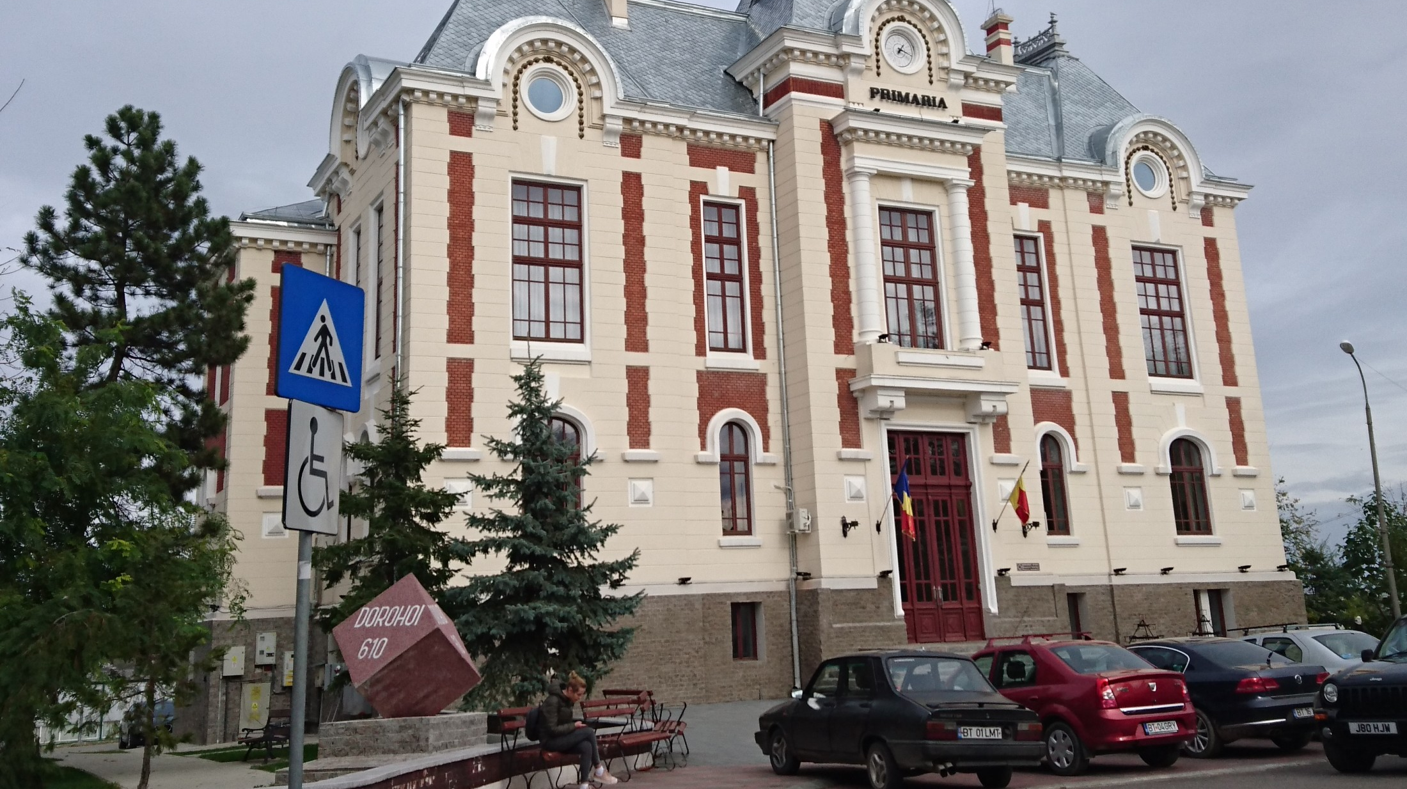
THANK YOU SO MUCH FOR YOUR ATTENTION
WE TRIED TO MAKE THIS PRESENTATION AS SHORT AS POSSIBLE TO KEEP EVERYONES ATTENTION. IF YOU HAVE ANY QUESTIONS DO NOT HESITATE TO ASK

