Slide 1







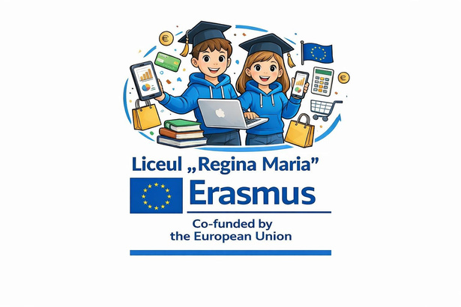


ERASMUS PROJECTS
AT OUR
HIGHSCHOOL
Mobility group of students
in Erasmus Project - Accreditation in School Education,
no. 2025-1-RO01-KA121-SCH-000318883

Slide 2

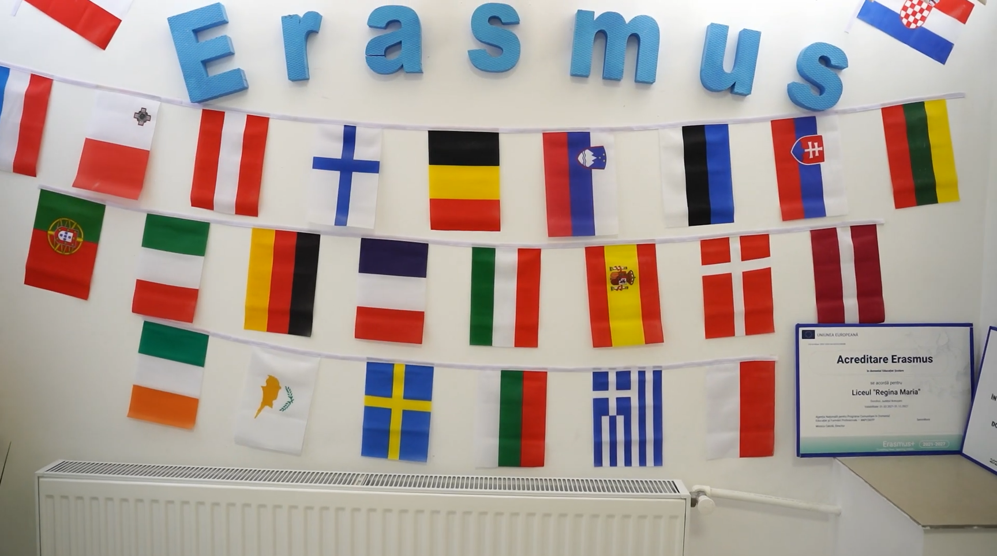



WHAT IS ERASMUS+?
I am Mrs. Samantha Wilson.
I'm your English Teacher.

Slide 3




Erasmus+ is a European Union programme that helps students and young people:
  study, train, or gain experience abroad
  take part in cultural exchange
  develop international cooperation
It offers opportunities to:
  learn new skills
  discover different cultures
  make friends from other countries
  grow more confident while having fun

Slide 4
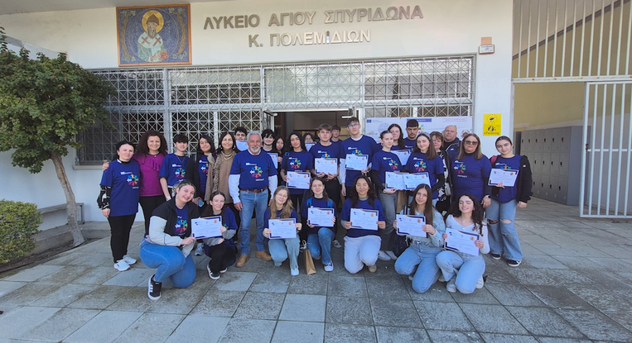
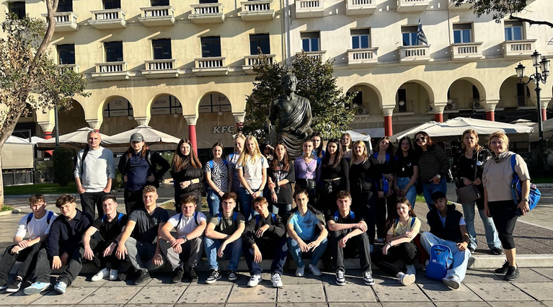
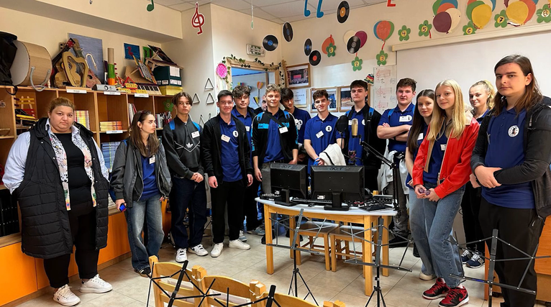
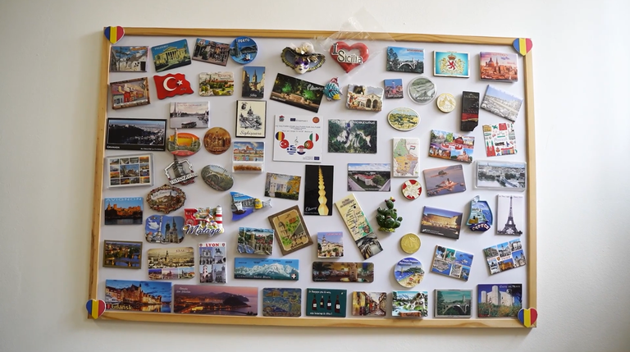
The “Regina Maria” High School in Dorohoi carries out European projects through the Erasmus+ program, which means that students and teachers can access learning, mobility, and collaboration opportunities at the European level.

Slide 5
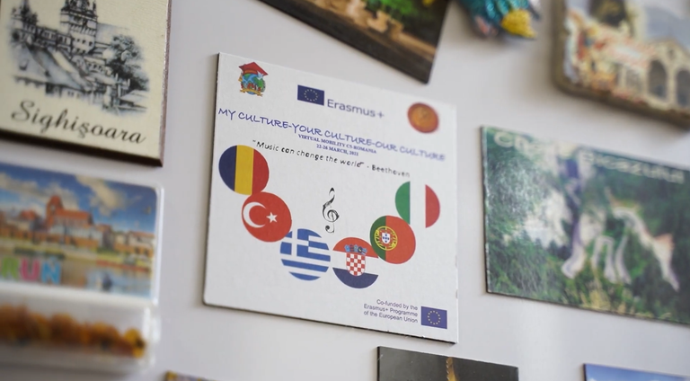
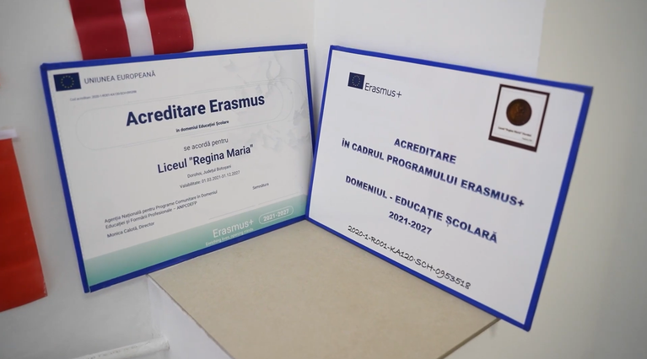
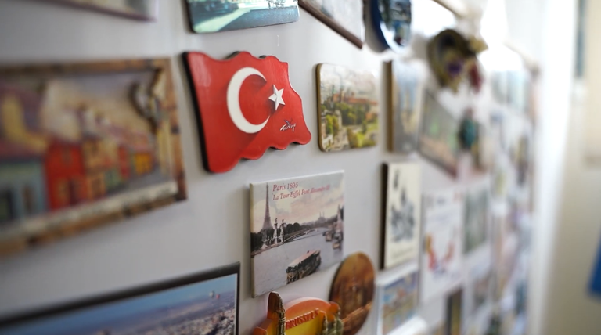
ACTIVE ERASMUS+ PROJECTS

Slide 6


On the school’s website, Erasmus+ programs include:
  SMART SOLUTIONS – KA220 Partnership in the educational field (collaboration with partner schools in other EU countries);
  Accreditation in Professional Training– VET (2024‑2027);
  Accreditation in school education (2021‑2027).

Slide 7
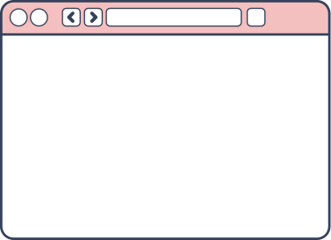




SMART SOLUTIONS
Three main topics addressed by the project
Inclusion, promoting
equality and non-
discrimination
Digital skills and
competences
Key competences
development

Slide 8



PROJECT
OBJECTIVES
1. To improve digital skills among students from
marginalized backgrounds and economically disadvantaged
households
2. To provide equitable access to educational resources
3. To create opportunities for collaborative learning
among students, encouraging teamwork and peer
support

Slide 9
ACCREDITATION IN PROFESSIONAL TRAINING
  The project is for students in the technological track and the math–informatics track.
  Its goal is to improve training quality through international mobility and better learning and evaluation tools.

Slide 10


PROJECT
OBJECTIVES
  1. Training 90 students in Services and IT to a higher quality level.
  2. Improving the language, social and cultural skills of 90 students through real professional experience.
  3. Supporting at least 45 students from disadvantaged backgrounds to enter the job market.
  4. Improving teaching quality by involving 12 teachers in observation programs across Europe.

Slide 11



ACCREDITATION IN SCHOOL EDUCATION
„Regina Maria” High School has obtained funding under the ERASMUS+ Programme for the period 2021-2027, and will carry out training activities for teaching staff and Mobility group for students in European countries, on topics such as:

Slide 12

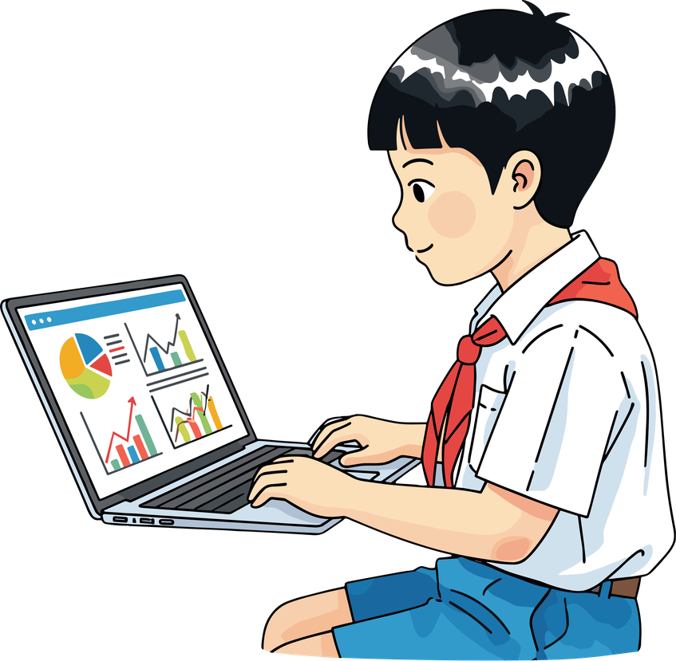


  Institutional management.
  Integration of digital tools in the class
  Promoting inclusion, preventing bullying and cyberbullying, reducing the risk of school dropout.
  Strategies of teaching
  Integration of graduates into the labour market

Slide 13





